Slide 1
Active Employees by department
Most number of employees are in IT department and least in Accounting Department

Slide 2
Avg Salary and AGE
Engineering department have Employees of Age greater than other department.
Marketing Department have greatest Annual Salary

Slide 3
Gender
There are more Female Employee than Male.
The Average Salary For Male is greater than female

Slide 4
Ethnicity
Most No of Employees are Asian and the lowest no of employees are black
The average age and salary for Asian is greater than from others
Black have the lowest avg age and salary

Slide 5
Country
Most of the employees are from United Sates and the lowest from Brazil
The average salary of the China is the greatest and Brazil have the lowest average salary

Slide 6
Bonus
There is maximum 40% bonus offered to a employee
The average bonus for marketing is the highest while the IT avg bonus in lowest
Out of 1000 employees only 475 employees got bonus

Slide 7
Gender wise bonus
Males have higher Avg bonus than female
Out of 518 female only 243 got bonus
Out of 482 male only 232 got bonus

Slide 8
Hiring
Most number of hiring was done in year 2021
And the least hiring was done in year 1993

Slide 9
Exited
In 2021 highest no of people exited.
Most no. employees exited from Engineering ,IT and Marketing

Slide 10
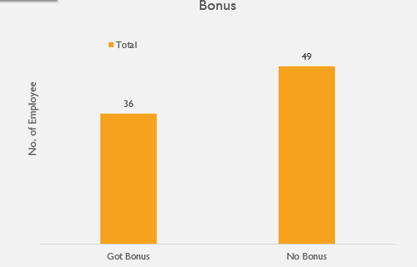
Status
Out of 1000 employee 85 have exited
In which out of 85 only 36 got bonus 49 got no bonus

Slide 11
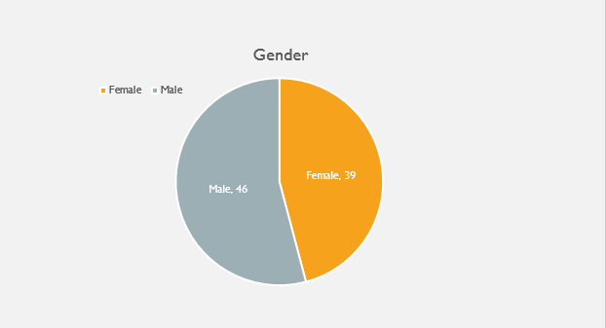
Status
Most of exited employees were from United States 59 and least from brazil 11
Out of 85,46 were male and 39 were female

Slide 12
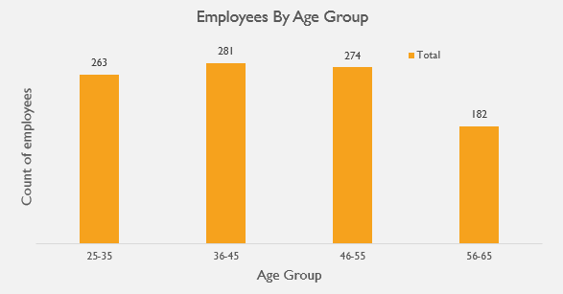
Age Group
Highest Number of employees are from age group 36-45 and lowest from 56-65
Avg Bonus for age group 36-45 is higher from others

